Slide 1
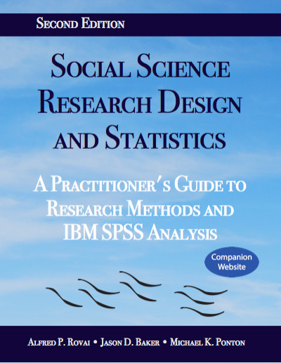
Social Science Research Design and Statistics, 2/e
Alfred P. Rovai, Jason D. Baker, and Michael K. Ponton
Modifying Syntax
PowerPoint Prepared by
Alfred P. Rovai
IBM® SPSS® Screen Prints Courtesy of International Business Machines Corporation,
© International Business Machines Corporation.

Slide 2
Modifying Syntax
The SPSS programming language, referred to as syntax, executes commands that originate with the SPSS drop-down, menu-driven interface (i.e., the graphic user interface (GUI)). Syntax scripts are visible using the SPSS Syntax Editor and can be modified and then executed, providing the SPSS user with the ability to generate output that cannot be generated using only the SPSS GUI.
Alternatively, one can develop syntax from scratch or acquire a syntax file from a source like the Internet and execute it by pasting the syntax in the Syntax Editor and executing the Run command. (Variable names used in the syntax may need to be changed in order to apply the syntax to the active dataset.)

Slide 3
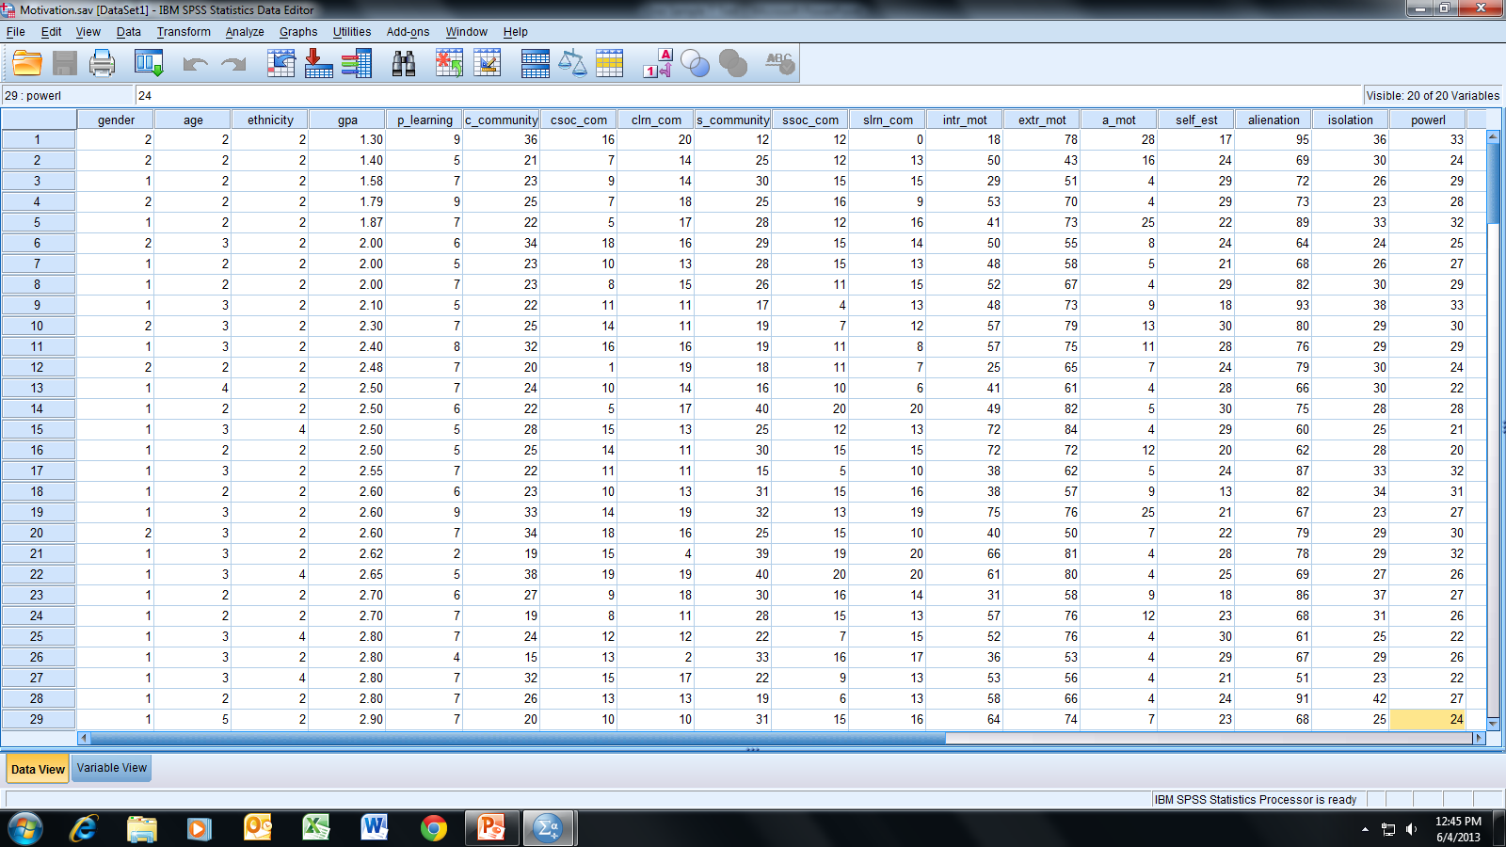
Open the dataset Motivation.sav.
File available at http://www.watertreepress.com/stats
TASK
Modify SPSS syntax in order
to change SPSS output.

Slide 4
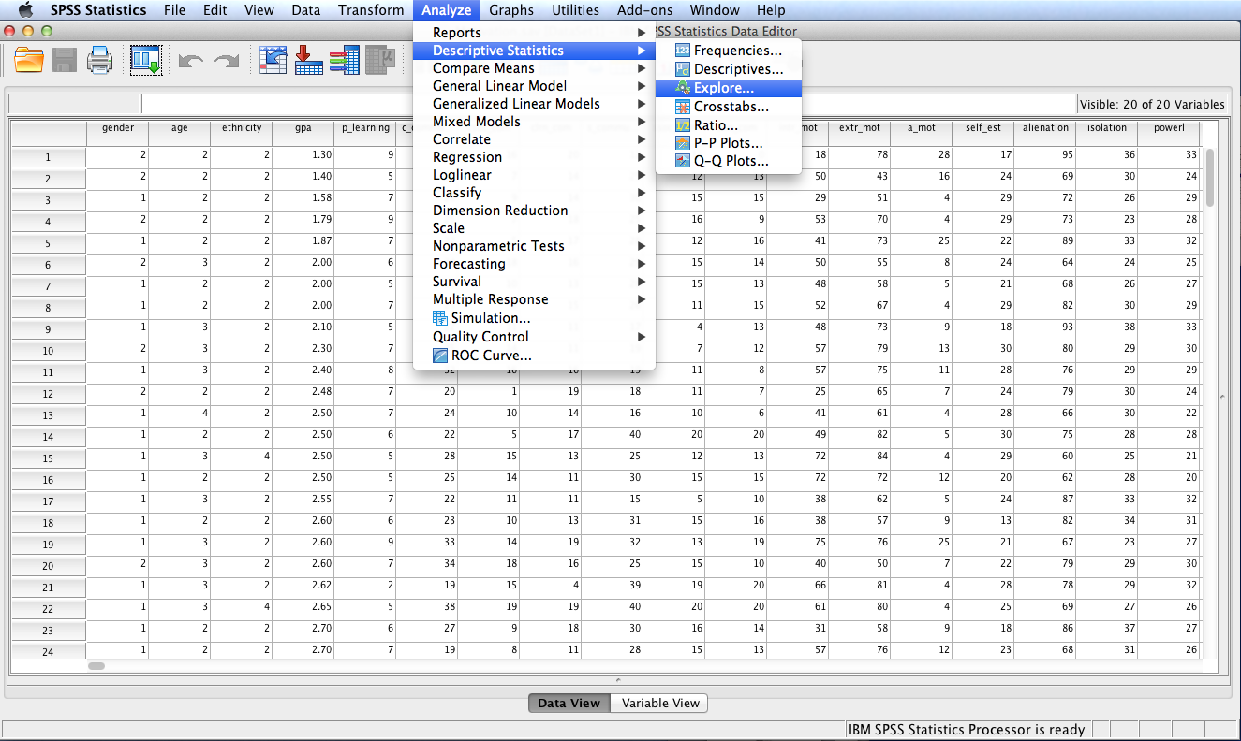
Follow the menu as indicated.

Slide 5
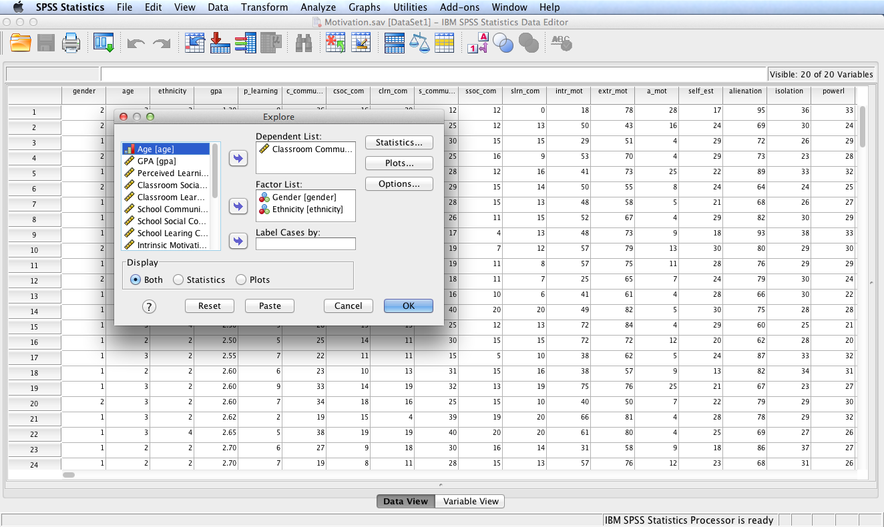
Move Classroom Community to the Dependent List: box. Move Gender and Ethnicity to the Factor List: box. Click OK.

Slide 6
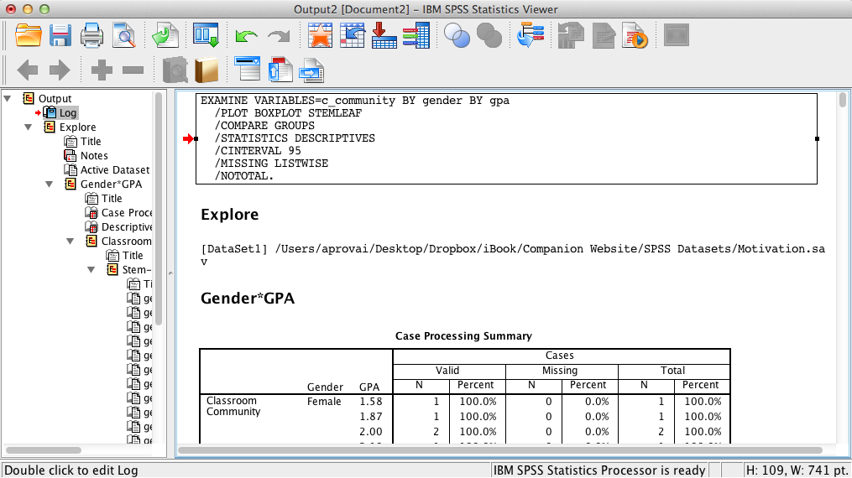
SPSS Output
SPSS output includes the contents of the SPSS Log that displays the syntax used to generate the output.

Slide 7
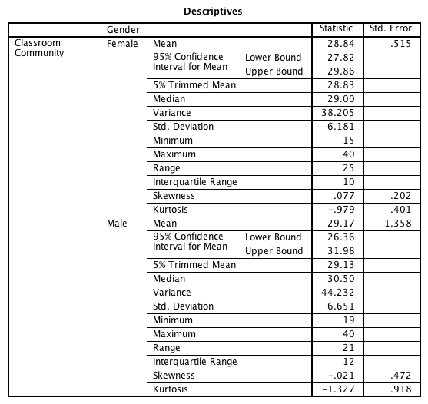
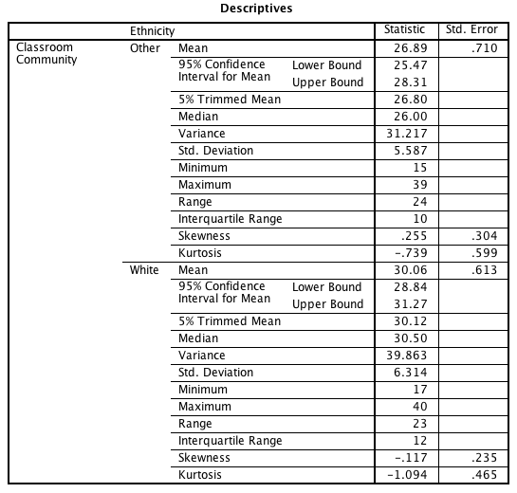
SPSS Output
SPSS output also includes two Descriptives tables, one for each factor. Additional output is provided by SPSS, to include boxplots and stem-and-leaf plots for each factor.

Slide 8
Return to the Explore dialog and click Paste to access the Syntax Editor.

Slide 9
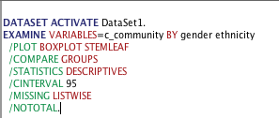
SPSS Syntax
The Syntax Editor opens displaying the SPSS syntax that generates SPSS output for the selected Explore procedure.
EXAMINE – This command is followed by the VARIABLES keyword, an = sign, the dependent variable, the BY keyword, and the two factors.
/PLOT – This sub-command followed by keywords BOXPLOT and STEMLEAF specifies that boxplots and steam-and-leaf plots will be generated.
/COMPARE – This sub-command controls how boxplots are displayed.
/STATISTICS – This subcommand specifies the generation of descriptive statistics.
/CINTERVAL – This sub-command followed by 95 specifies a 95% confidence interval.
/MISSING – This sub-command followed by LISTWISE specified that the procedure will exclude cases listwise (instead of pairwise) when handling missing values.
/NOTAL – This sub-command specifies that the charts should not be created for the overall group but only for the listed factors.
. – The final period terminates the procedure.

Slide 10
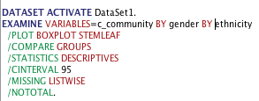
SPSS Syntax
SPSS generated syntax for the requested Explore procedure.
Modify the syntax by entering keyword BY between gender and ethnicity.

Slide 11
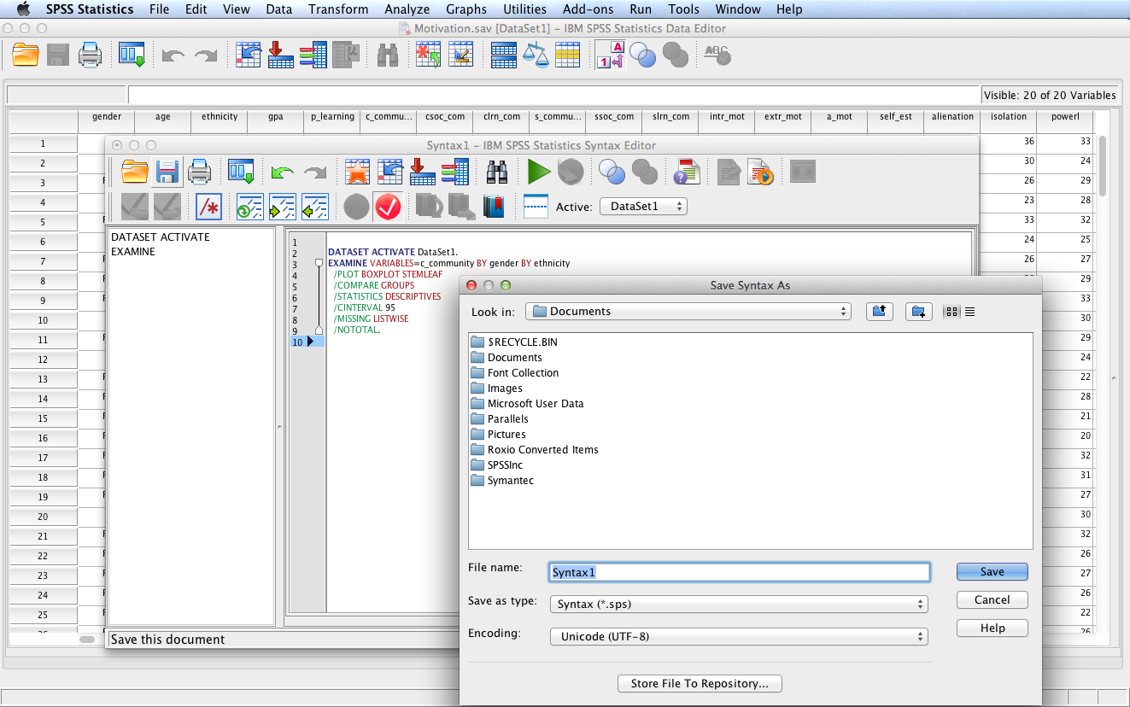
If desired, click the Save this document icon to open the Save Syntax As dialog.
Enter a descriptive name for the file and then click Save to save the syntax as a .sps file.

Slide 12
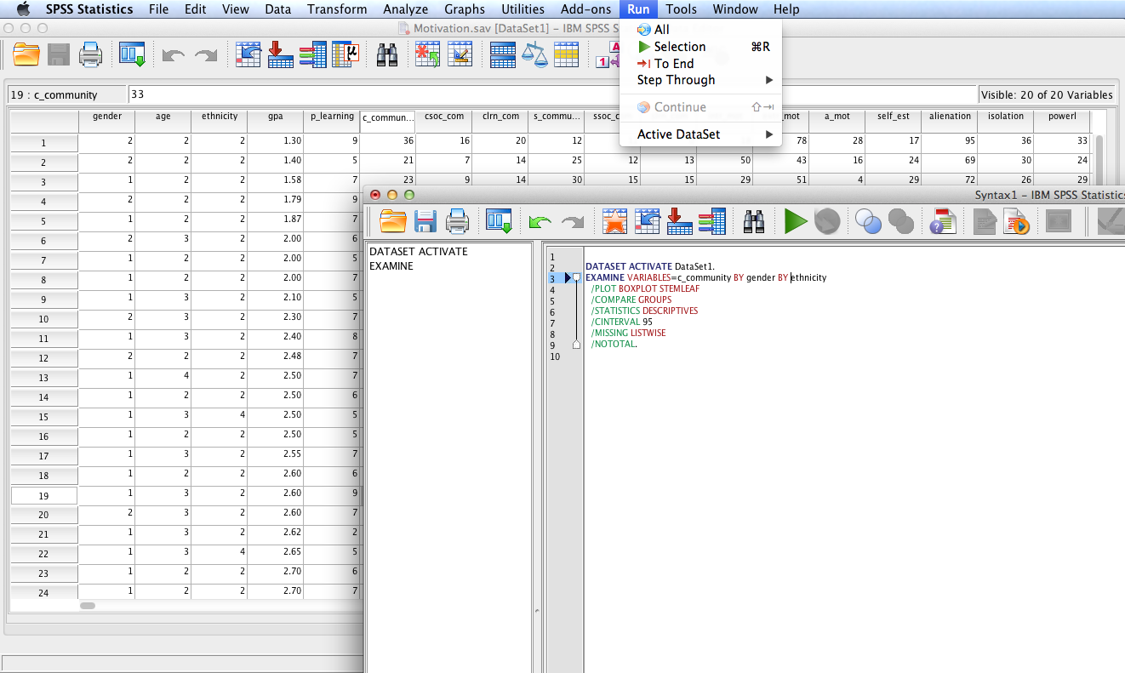
Using the Run SPSS menu item, click All in order to run the entire modified syntax.

Slide 13
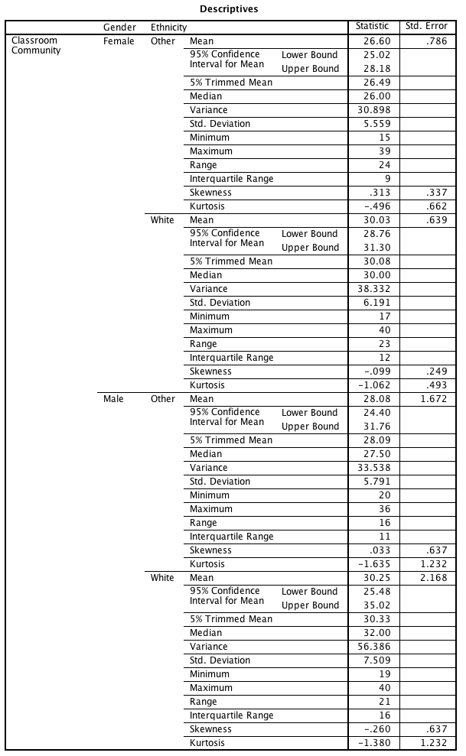
Previous SPSS Output
New SPSS Output
Notice the effect on SPSS output of modifying the syntax. SPSS produces a single table with layers.

Slide 14
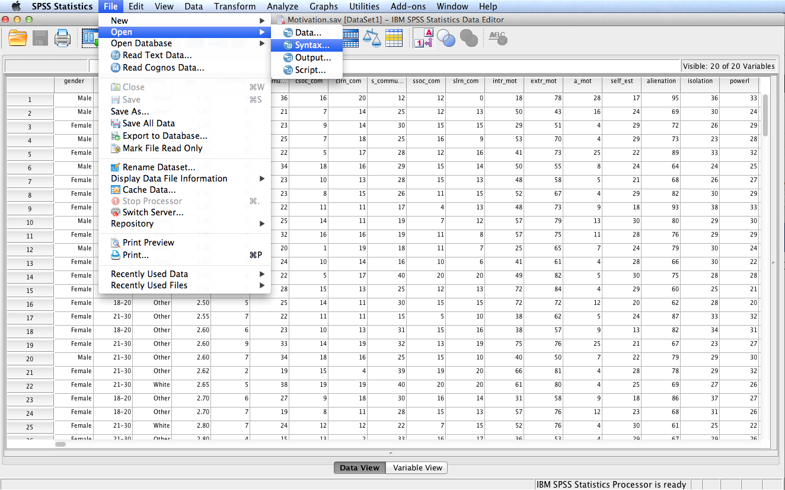
Follow the menu as indicated to open a previously saved syntax file.

Slide 15
Modifying Syntax
The SPSS graphic user interface (GUI) is fine for most procedures; however, using the Syntax Editor in addition of the GUI can increase productivity. Many SPSS syntax files and modifications are available on the Internet and in books that can automate many procedures and save time.

Slide 16
End of Presentation

